Slide 1
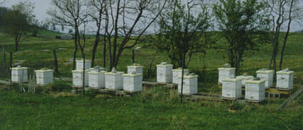
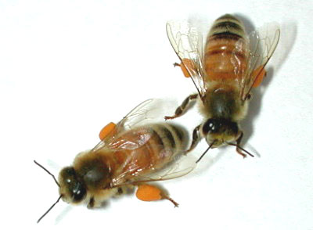
Bee Health in North America Understanding Colony Decline
Rick Fell, Professor Emeritus
Department of Entomology
Virginia Tech

Slide 2
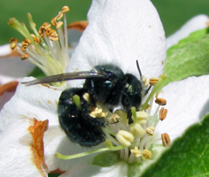
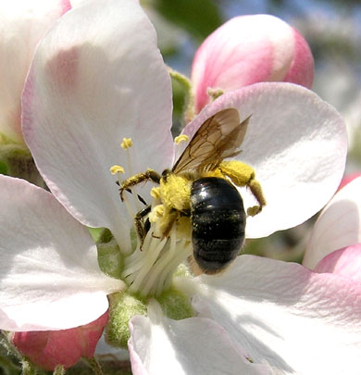
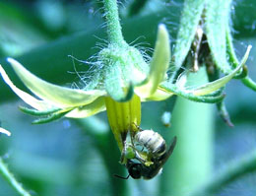
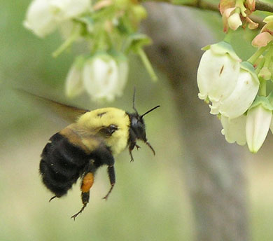
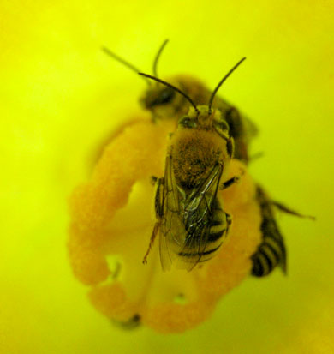
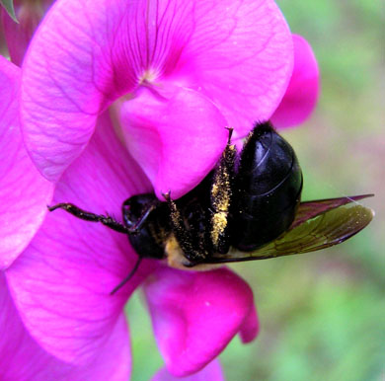
There are approximately 3500 species of bees in North America (Tripplehorn and Johnson. 2005)
Osmia sp.
mason bee
Halictid family
sweat bee
Andrena sp.
mining bee
Bombus griseocollis
bumble bee queen
Xylocopa virginica
carpenter bee
Peponapis pruinosa
squash bee
Notes:
In the mid-Atlantic we have roughly 500 species of bees. Though the effectiveness of many non-Apis bees is documented, we still tend to assume that honey bees are providing the majority of pollination.

Slide 3
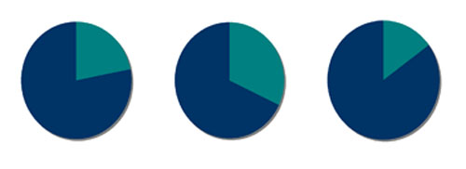
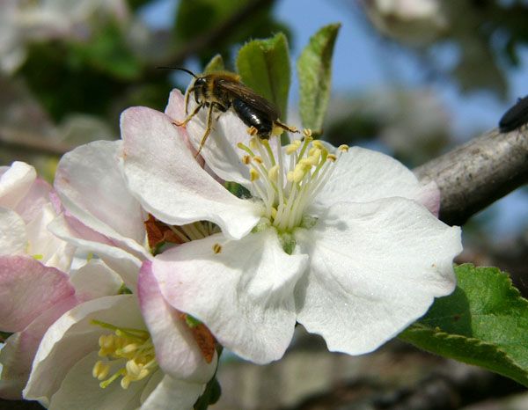
Non-Apis Bees as Pollinators
Many species of non-Apis bees are important contributors to the crop pollination
Increased interest in the management and utilization of non-Apis bees for crop pollination
Need to protect these pollinators through increased conservation efforts and careful pesticide use
Apple Caneberry Cucurbits
Percentages of honey bees ( ) and non-Apis ( ) bees visiting crop flowers.
Adamson, Roulston, Fell & Mullins. 2012. Environ Ent 41:813-821

Slide 4
Value of Bee Pollination
Worldwide basis - the value of pollination is estimated at $225 billion per year (Gallai et al. 2009)
87 of the leading global food crops are dependent on pollinators
In the U.S. the estimated benefits of honey bees to agricultural crop pollination: $15 billion per year
In U.S. 2 - 2.5 million honey bee hives are rented annually for the pollination of crops

Slide 5
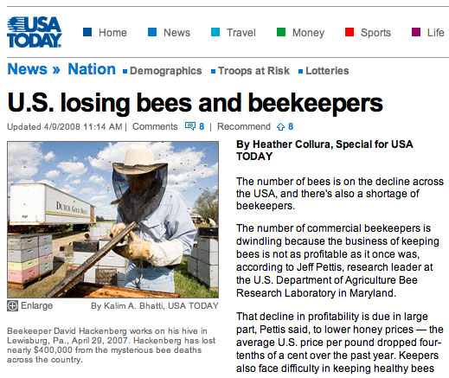
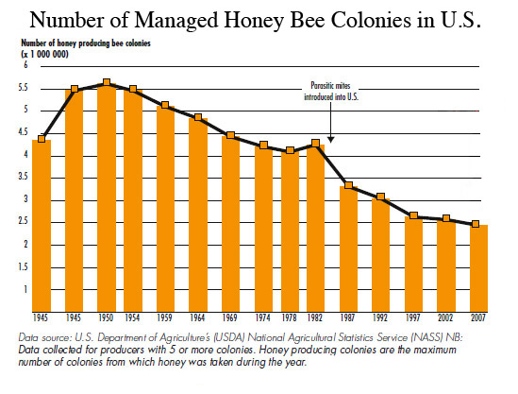
Current Status of Honey Bees
Honey bee populations have declined significantly in the U.S. in last 60 years
In Virginia the number of managed colonies is down over 50% since the mid 1980’s
Current annual losses of managed hives average 30% in Virginia
Mean Loss = 31%
CCD
Mean percent annual colony losses in Virginia

Slide 6
Tracheal mite first discovered in VA
Varroa mite first discovered
Feral colonies
No. of Honey Bee Colonies
Today
Estimated Number of Honey Bee Colonies in Virginia

Slide 7
Causes of Colony Loss
Large declines starting in 1980s due to parasitic mite introduction
Recent declines attributed to Colony Collapse Disorder (CCD)
CCD involves rapid loss of adult bee population, leading to colony death
In Virginia, most colony losses occur during the winter
Some losses exhibit symptoms of CCD, but colony health is a significant factor
Impact of pesticides and pesticide residues are largely unknown

Slide 8
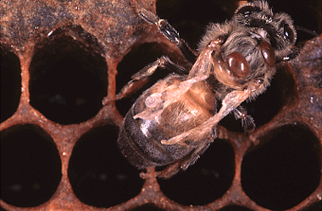
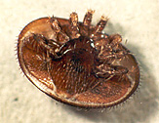
Effects of the Varroa Mite on Honey Bees
Feeding of the mites causes damage to the developing bees:
feeding damages tissue, can shorten bee’s life span
mites vector virus to pupae, DWV (deformed wing virus)
Mite feeding has been associated with an increased incidence of viral diseases in adults (chronic and acute bee paralysis, IAPV)
Varroa mites increase stress on colonies, suppress bee’s immune system, and increase susceptibility to other diseases such as Nosema
Major factor in increased winter losses
Control of varroa mites has been a major concern

Slide 9
Colony Collapse Disorder (CCD)
Sudden loss of a colony’s population of adult bees leading to colony death
Disorder is characterized by:
An absence of adult bees in colonies with few dead bees, if any, in the hive or in front of the hive
Frequent presence of capped brood in colonies
Presence of food reserves (honey, pollen) that had not been robbed out, and hives not attacked by pests such as wax moths
In colonies that still have bees, characterized by small clusters with a laying queen, not responsive to stimulative feeding

Slide 10
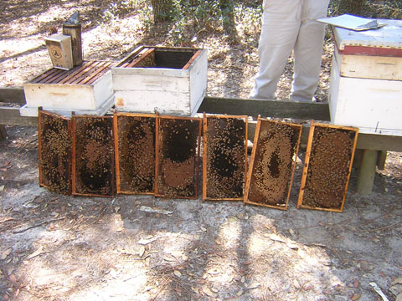
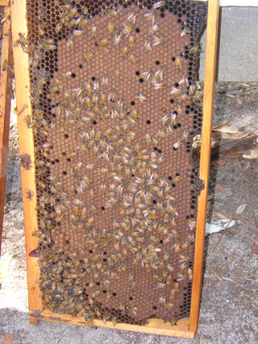
Colony Collapse Disorder
Photographs from a collapsing colony in Georgia. Large amounts of brood but few adults. (photos from Jeff Pettis, USDA)

Slide 11
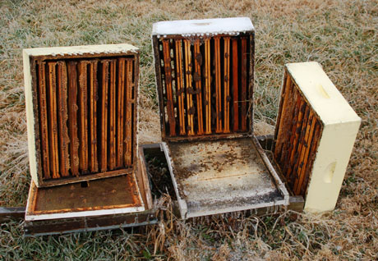
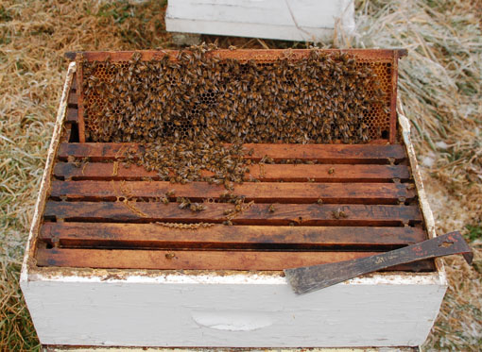
Colony Collapse vs. Winter Loss
CCD is characterized by an absence of bees, the presence of food reserves, and often capped brood.
Typical winter loss - lack of food, plus presence of dead bees

Slide 12
CCD - A New or Old Problem?
Similar symptoms reported as early as 1890’s: Disappearing Disease, first reported in 1915
Large losses of adult bees with no accumulation of dead bees in the hive or at the entrance
Queens were generally the last to be affected
Pollen and honey stores were normal and often abundant in dead hives
No single pathogen was ever identified or associated with the disorder

Slide 13
Causes of Honey Bee Colony Decline

Slide 14
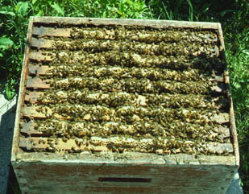
Where Do We Stand On CCD and Colony Decline?
No specific cause has been identified
No environmental agents or chemicals stand out as being causative agents
Possible causes of colony decline
Chemical (pesticide) residues/contamination
Parasite loads (especially Varroa)
Pathogens of bees or brood: viruses (ABPV, KBV, IAPV, BQCV, DWV, SBV), Nosema ceranae, Idiopathic brood disease syndrome
Queen failure (relative risk colony mortality increases)
Colony stress (compromises immune system, may disrupt social system) - possible causes include poor nutrition, movement (migratory stress), environmental factors (drought, cold temperatures), pesticides

Slide 15
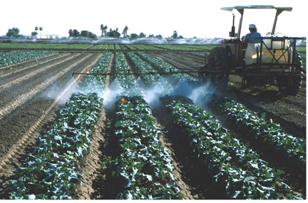
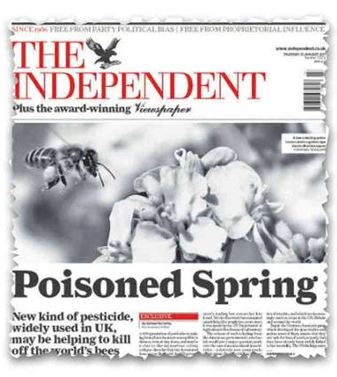
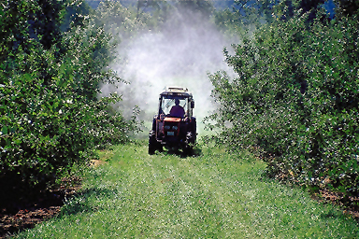
Pesticides and Bees

Slide 16
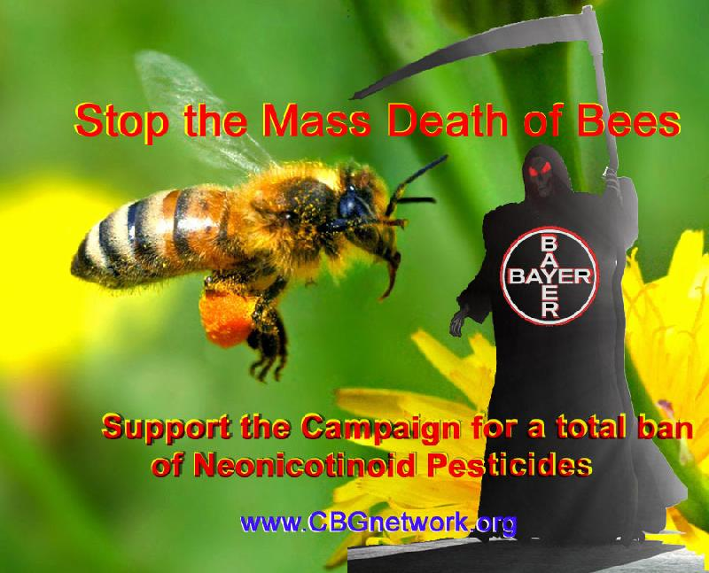
Neonicotinoid Insecticides

Slide 17
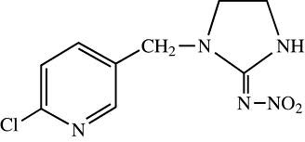
Neonicotinoid Insecticides
Imidacloprid
Relatively new class of insecticides which act on postsynaptic nicotinic acetylcholine receptors
Mode of action based on nicotine, act on CNS of insects
Higher toxicity to insects than mammals; specific neuron pathway more abundant in insects
Major neonicotinoids of concern– imidacloprid, thiamethoxam, clothianidin
Major concerns have been their use as seed treatments (corn, canola, sunflower, soybeans) and the release of contaminated dust during planting

Slide 18
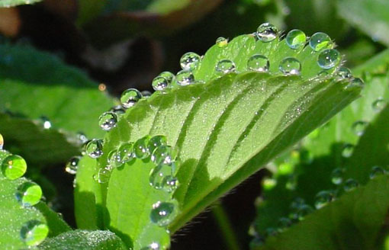
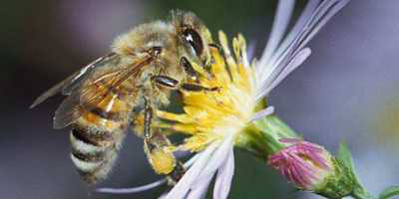
Neonicotinoid “Problems”
Neonicotinoids are highly toxic to bees and have been blamed as a leading cause of CCD and colony decline
Neonicotinoids are systemic and can lead to contamination of pollen and nectar
Can lead to residues in the hive in pollen (~3ppb) and wax (0.1 ppb) - levels below acute and chronic toxicity levels
May be released by guttation in seedlings
Guttation droplets
Pollen and nectar collection
Notes:
Imidacloprid mean LD50 = 280 ppb

Slide 19
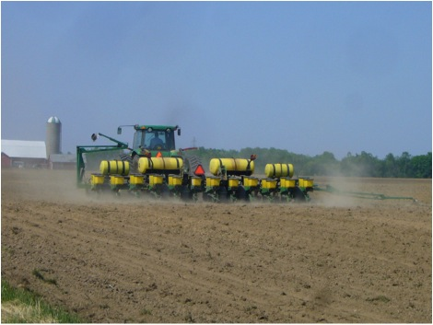
Are Neonicotinoids Really the Problem?
To many beekeepers and popular press – Yes
Use banned in France, Italy and Germany, and for some uses in England.
Is there evidence for problems – Some
In 2008 - large bee kills in Germany associated with contaminated dust released during the planting of treated corn seed
2011 bee kills associated with corn planting in Indiana – thiamethoxam and clothianidin detected in planter exhaust materials (talc)

Slide 20
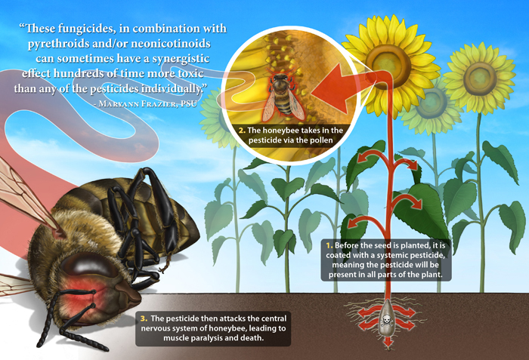
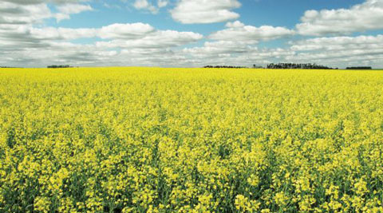
Are Neonicotinoids Really the Problem?
Does the contamination of nectar/pollen cause problems
Currently no good evidence for problems
Studies with clothianidin treated Canola seed show no effects on bee mortality, longevity, or brood development
Other concerns for neonicotinoid toxicity
Synergistic effects
Interactions with pathogens
Field of canola (rape)

Slide 21
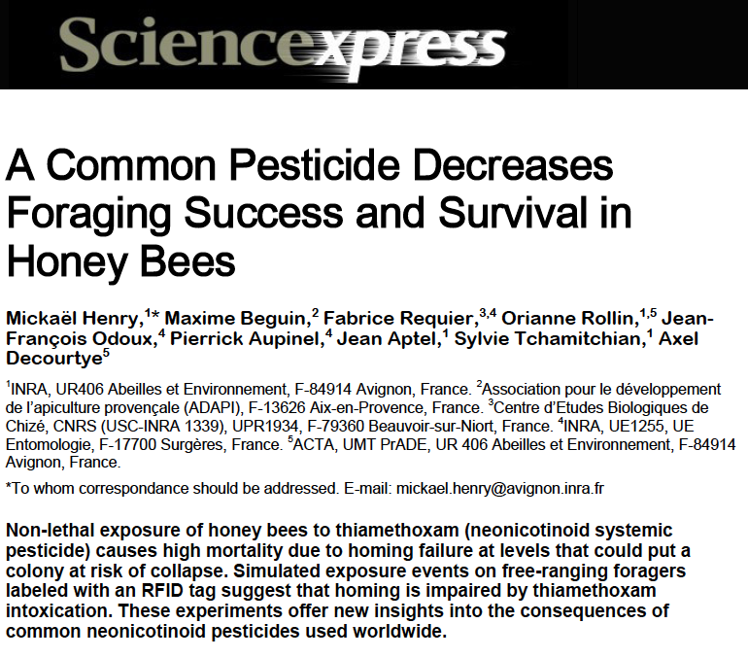
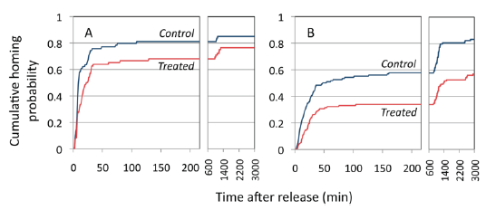
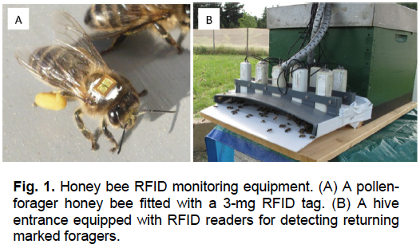
Efforts to Link Neonicotinoids to Bee Decline
(March 2012)
Homing probability of bees released in A. familiar area B. random area
Importance of using field-realistic doses
Notes:
Dose used was 1.34 ng in 20 ul of sucrose solution

Slide 22
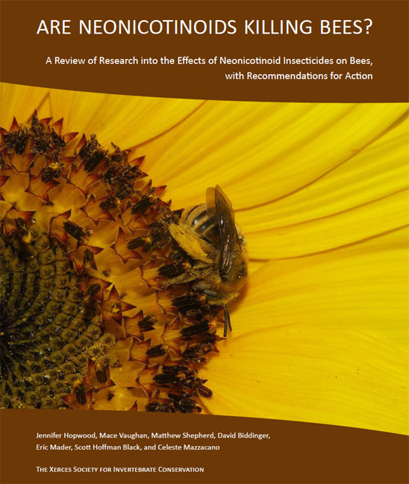
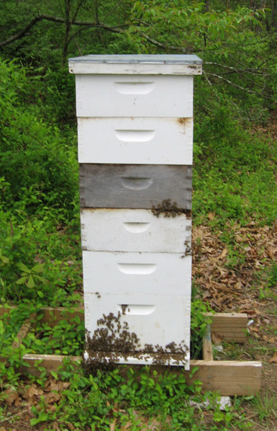
Neonicotinoids and CCD
‘There is no link demonstrated between neonicotinoids and the honey bee syndrome known as Colony Collapse Disorder.’
Laboratory studies have shown lethal and sublethal effects on bees; however we do not see high colony losses from the field use of neonicotinoids
Field relevant doses do not appear to affect:
Learning performance or orientation
Colony social behavior
Brood production
Colony mortality

Slide 23
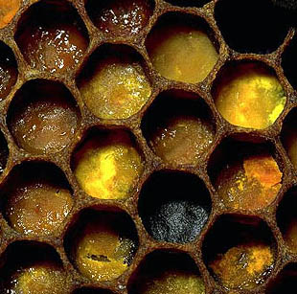
Residues in Hive Materials
Chemical analysis of pollen, honey, bees and beeswax has been conducted
121 different pesticides and metabolites have been found
92% of bee, pollen and wax samples contained multiple residues of 2 or more pesticides
~60% of wax and pollen samples contained at least one systemic pesticide residue (most are fungicides)
Average pollen sample contained 7 residues and the average beeswax sample 8 residues
Neonicotinoid insecticides identified in < 1% of wax samples, and < 3% of pollen samples
Two most common residues were miticides used by beekeepers

Slide 24
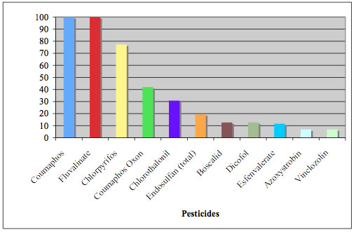
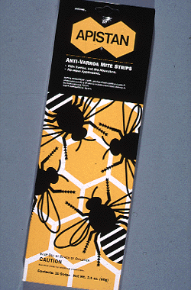
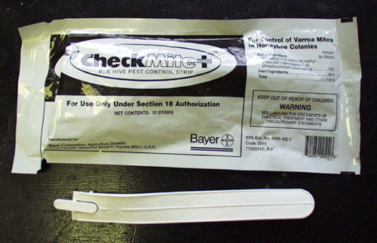
Residues in Hive Materials
Chemical analysis of beeswax
Accumulation of tau-fluvalinate, coumaphos in beeswax – 98% of beeswax samples contaminated
Mean levels: 7.47 ppm + .97 ppm
Sublethal doses can affect bees - could this be a factor in colony decline?
Frequency detection
Pesticides in brood nest wax

Slide 25
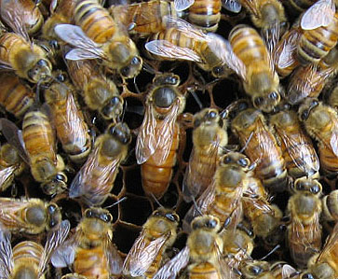
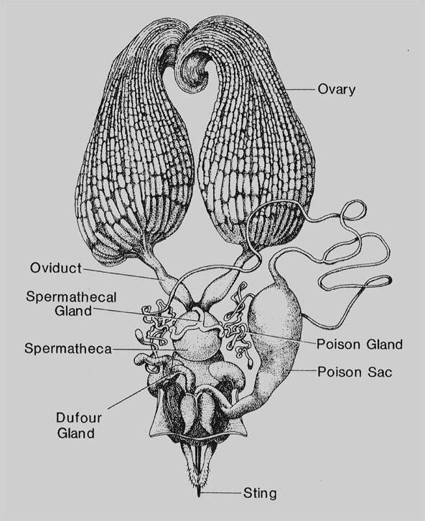
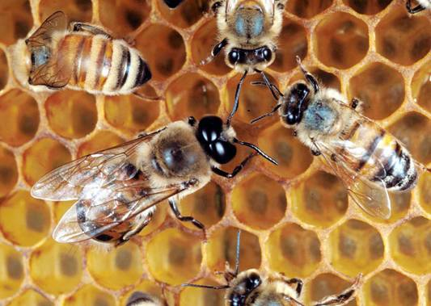
Miticide Effects on Colony Health
Decreases drone production
Inhibits queen rearing, matings unsuccessful
Reproductive physiology of drones and queens
Reduces sperm production and viability in drones
Causes a loss of sperm viability over time
May affect sperm in the spermatheca of the queen
Burley, Fell & Saacke, 2008. J. Econ Ent 110:1081-1087

Slide 26
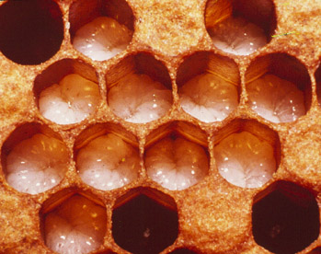
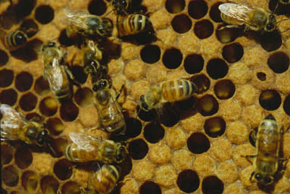
Effects of Pesticide Residues in Comb on Colony Health
Examine sub-lethal effects of pesticide residues in beeswax
Major residues coumaphos and fluvalinate, plus mixture others pesticides
Pesticide residues in comb
delay larval development and adult emergence
shorten adult longevity
may affect hive labor roles of adults and foraging activity
may affect immune response and disease susceptibility
Wu et al. 2011. PLoS One 6(2):e14720

Slide 27
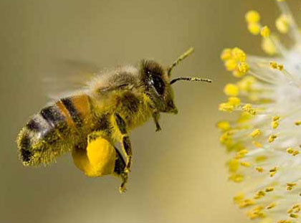
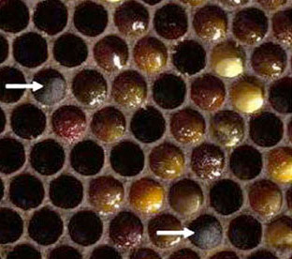
Pesticide Effects on Colony Health
Fungicides can reduce mycoflora in beebread and may affect natural resistance mechanisms in colony, especially to fungal disease
Pesticides (including antibiotics) can affect the microbiota of the honey bee, compromising the immune system and overall bee health
Pesticide spray adjuvants (such as organosiloxane surfactants) may affect learning and increase bee mortality
‘entombed’ pollen

Slide 28
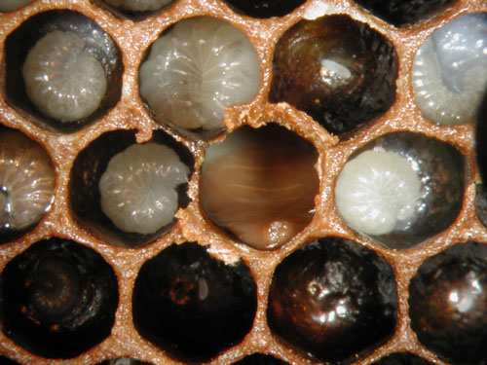
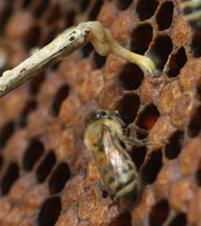
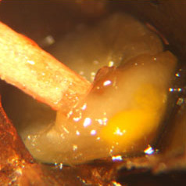
Bee Pathogens and Colony Health
Honey bee colonies with CCD have higher pathogen levels and are co-infected with a larger number of pathogens than non-CCD colonies
Israel Acute Paralysis Virus found in 96% of CCD colonies, but other viruses are common (Deformed wing virus, Black queen cell virus, Kashmir bee virus)
Fungal pathogens (Nosema spp) have been reported as a possible cause of colony decline
Idiopathic brood disease syndrome (IBDS) increases risk of colony mortality by ~ 4X

Slide 29
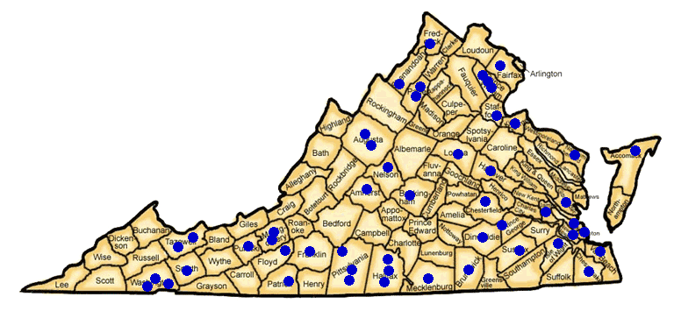
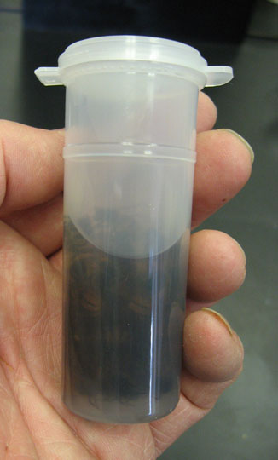
Status of Nosema in Virginia
Conducted a statewide survey in 2009
Goal to determine the prevalence of Nosema and which species were present
Analyzed samples from 305 hives
Samples were analyzed for Nosema using spore counts and a molecular analysis (multiplex real-time PCR)
Based on molecular analysis 69.3% of hives were infected with N. ceranae, but only 2.7% with N. apis
Prevalence and infection levels do not indicate a significant cause of bee decline
Samples from individual hives
(Traver and Fell. 2011. Jour Invert. Path.)

Slide 30
Pesticide/Pathogen and Pathogen/Pathogen Interactions
Pesticide exposure may impact honey bee susceptibility to Nosema infection and mortality of infected bees (Alaux et a. 2010, Vidau et al. 2011, Pettis et al. 2012)
Caveat: effects not yet demonstrated in natural colonies Pesticides are known to affect the immune systems of insects and could affect the susceptibility of bees to diseases
Nosema has been implicated in synergistic effects with other pathogens (BQCV)
Varroa mites weaken the immune system of bees and may trigger viral multiplication
Nosema spores
Varroa on pupa

Slide 31
Cell Phones and CCD - Is there a link?
Reports from Europe suggested that cell phones placed near colonies cause disorientation in bees
Suggestion that cell phone towers could be a contributing factor to colony losses

Slide 32
Bee Health and Colony Decline in Context
Annual colony losses average ~30% in U.S.; approximately 10% of colonies that die have CCD-like symptoms
Colony mortality is the product of multiple factors and CCD may be the result of multiple stresses
Major mortality factors include starvation, queen failures, parasitic mites, pathogens, nutritional fitness, pesticides
There is no evidence that specific insecticides like the neonicotinoids have a more significant role in colony decline

Slide 33
Collaborators and Acknowledgements
Virginia Department of Agriculture & Consumer Services
Virginia Agriculture Council
Virginia State Beekeepers Association
National Honey Board
Fell Lab Members
Brenna Traver
Grace Mulholland
Troy Anderson Lab
Carlyle Brewster Lab
USDA Beltsville Bee Lab
Judy Chen
Jay Evans
Michele Hamilton

